Slide 1
Thyroid Disease Prediction
Chandar Umaratkar (2146491245095)
Avantika Barudwale (21464912450100)
Jeevak Wankhede (2146491245114)
Prof. Gajanan Tikhe
Assistant Professor

Slide 2
1. Introduction
Thyroid disease refers to conditions affecting the thyroid gland, leading to hyperthyroidism, nodules, or cancer, disrupting metabolism and various bodily functions.
Thyroid disease is a common cause of medical diagnosis and prediction, with an onset that is difficult to forecast in medical research.
The thyroid gland is one of our body's most vital organs.
Thyroid hormone releases are responsible for metabolic regulation.
Hyperthyroidism and hypothyroidism are one of the two common diseases of the thyroid that releases thyroid hormones in regulating the rate of body's metabolism.

Slide 3
2. Objectives & Scope of Project
Objectives:
To review existing methods of thyroid disease Prediction.
To explore recent advancements in thyroid disease Prediction techniques.
To highlight the importance of early Prediction in managing thyroid disorders.
To discuss the challenges associated with thyroid disease Prediction.
To suggest potential strategies for improving thyroid disease Prediction rates.
Scope of Project:
Examination of traditional clinical assessment methods for thyroid disease detection.
Review of standard laboratory tests used in diagnosing thyroid disorders.
Exploration of imaging studies such as ultrasound imaging and fine needle aspiration biopsy.
Discussion on the role of artificial intelligence and molecular testing in enhancing thyroid disease detection.

Slide 4
3. Stakeholders
Primary Stakeholders:
Patients: Individuals directly affected by thyroid disease, who rely on accurate Prediction methods for timely treatment and management.
Healthcare Professionals: Including endocrinologists, primary care physicians, nurses, and radiologists directly involved in diagnosing and treating thyroid disorders.
Medical Researchers: Conducting studies to develop and improve diagnostic tools and methods for thyroid disease Prediction.
Secondary Stakeholders:
Pharmaceutical Companies: Developing medications and treatments for thyroid disorders, which may rely on accurate Prediction methods for patient eligibility.
Insurance Providers: Responsible for covering costs associated with thyroid disease Prediction tests and treatments, which may influence access to diagnostic services.
Government Health Agencies: Responsible for setting healthcare policies, guidelines, and funding initiatives related to thyroid disease Prediction and management.

Slide 5
4. Literature Survey.
References: | Literature Survey
1. American Thyroid Association. (n.d.). Thyroid Disease. Retrieved from https://www.thyroid.org/thyroid-disease/ | This source provides comprehensive information on thyroid disease, covering its various aspects, symptoms, diagnosis, and treatment options. It serves as a foundational reference for understanding thyroid disorders in the context of the project.
2. National Institute of Diabetes and Digestive and Kidney Diseases. (n.d.). Thyroid Disease. Retrieved from https://www.niddk.nih.gov/health-information/endocrine-diseases/thyroid-disease | This reference offers valuable insights into thyroid disease from a medical perspective, highlighting its impact on health and the importance of accurate diagnosis and management. It complements the information provided by the American Thyroid Association.
3. Machine Learning Mastery. (2021). A Gentle Introduction to Random Forests, Ensembles, and Performance Metrics in Python. Retrieved from https://machinelearningmastery.com/gentle-introduction-random-forest-algorithm/ | This resource provides a beginner-friendly introduction to Random Forest algorithm and its application in machine learning. It discusses the principles behind Random Forest, ensemble learning, and performance evaluation metrics, which are relevant to the project's implementation of the algorithm.
4. Scikit-learn: Machine Learning in Python. (n.d.). Random Forest. Retrieved from https://scikit-learn.org/stable/modules/ensemble.html#forests-of-randomized-trees | This documentation from scikit-learn, a popular machine learning library, offers detailed information on the Random Forest algorithm implementation in Python. It serves as a technical reference for understanding the inner workings of Random Forest and its usage in machine learning projects.
5. GeeksforGeeks. (2021). K-Nearest Neighbors Algorithm in Python. Retrieved from https://www.geeksforgeeks.org/k-nearest-neighbours/ | This educational resource provides a tutorial on the K-Nearest Neighbors (KNN) algorithm in Python. It explains the concept of KNN, its implementation, and practical examples, which are relevant to the project's utilization of KNN for thyroid disease prediction.

Slide 6
5. Proposed Solution
Our solution for thyroid disease Prediction leverages a broad dataset encompassing various factors such as demographic details, medical histories, thyroid hormone levels, imaging results, and other relevant parameters. We employ two advanced machine learning algorithms: Random Forest and K-Nearest Neighbors (KNN), to analyze this dataset and predict the presence of thyroid disease.
Key Components:
1. Data Collection: Gather comprehensive data including patient demographics, medical records, thyroid hormone levels, imaging studies, and any relevant information related to thyroid health.
2. Data Preprocessing: Prepare the collected data by addressing missing values, encoding categorical variables, and scaling features as necessary for model training.
3. Model Training - Random Forest: Utilize the Random Forest algorithm to build an ensemble of decision trees that can effectively learn patterns indicative of thyroid disease risk.
4. Model Training - K-Nearest Neighbors (KNN): Implement the KNN algorithm, which classifies data points based on the majority class of their k nearest neighbors, to further enhance the accuracy of thyroid disease prediction.
5. Model Evaluation: Evaluate the performance of both Random Forest and KNN models using appropriate metrics such as accuracy, precision, recall, and F1-score.
6. Monitoring and Updating: Continuously monitor the performance of both models and update them as necessary with new data to ensure their accuracy and relevance over time.
By harnessing the capabilities of Random Forest and KNN algorithms, our solution aims to provide accurate and timely Prediction of thyroid disease, enabling healthcare professionals to intervene early and improve patient outcomes.

Slide 7
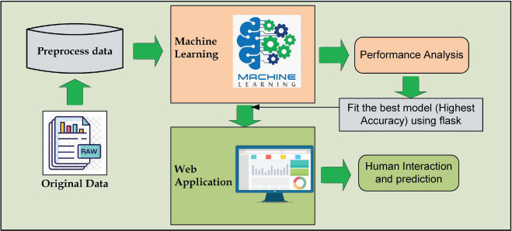

Slide 8
6. Technologies Used
1. Python: The programming language used for implementing the machine learning workflow.
2. Pandas: A powerful data manipulation library used for handling datasets, data preprocessing, and data analysis.
3. scikit-learn: A popular machine learning library in Python used for training machine learning models, hyperparameter tuning, and evaluation.
4. GridSearchCV: A class from scikit-learn used for performing grid search cross-validation to tune hyperparameters for machine learning models.
5. RandomForestClassifier: An ensemble learning algorithm from scikit-learn used for classification tasks, such as building the Random Forest model.
6. Streamlit: Web application framework for creating interactive applications

Slide 9
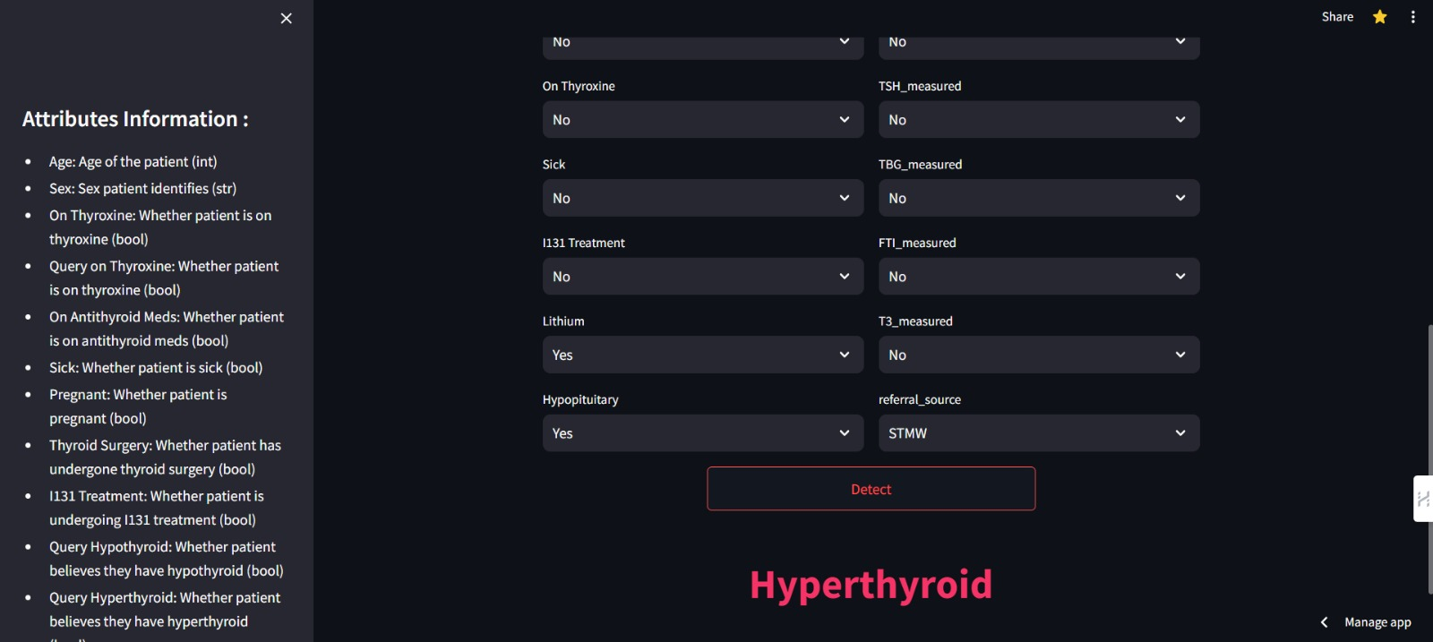
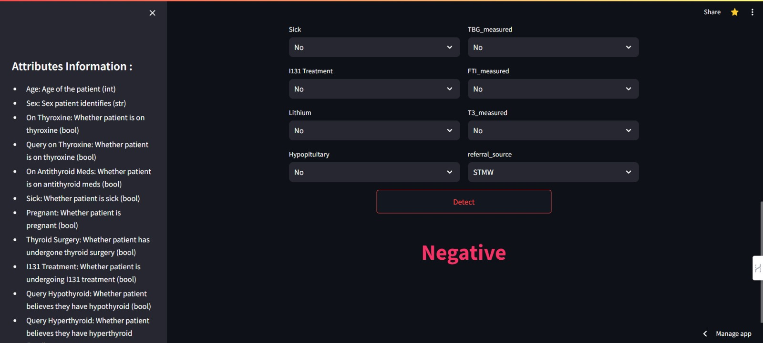
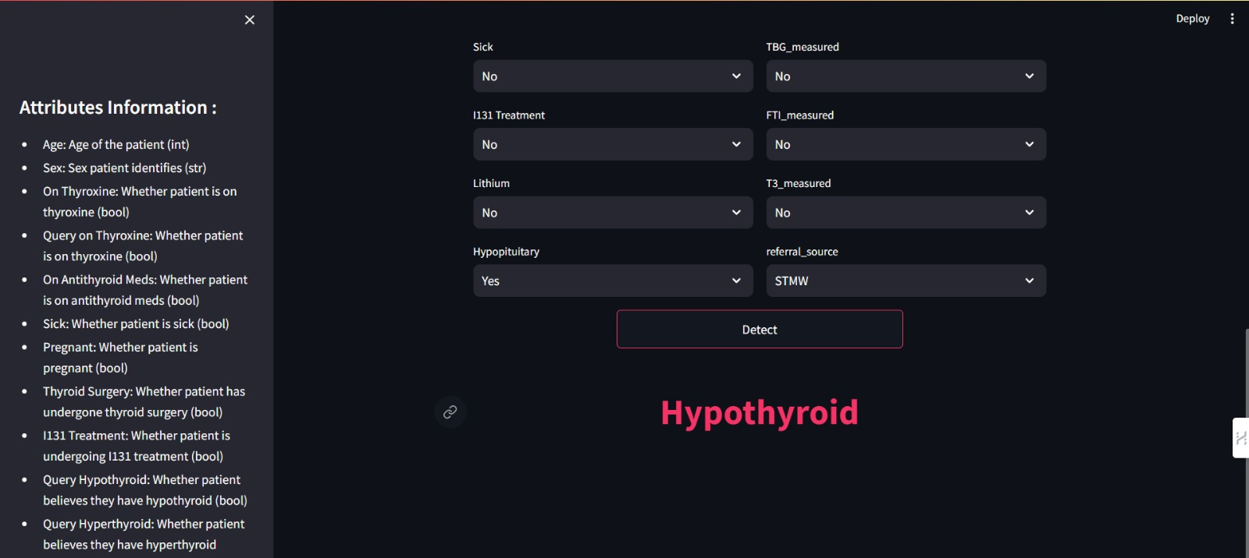
7. Output

Slide 10
8. Conclusion
Advancements in technology, particularly machine learning, hold significant promise for improving thyroid disease Prediction. Integrating predictive models with comprehensive patient data sets can enhance accuracy and early detection rates. Embracing these innovations is crucial for advancing healthcare and improving outcomes for individuals affected by thyroid disorders.

Slide 11
9. References
Thyroid Disease Prediction Using Selective Features and Machine Learning Techniques Thyroid Disease Prediction Using Selective Features and Machine Learning Techniques - PMC (nih.gov)
Thyroid detection using machine learning (PDF) THYROID DETECTION USING MACHINE LEARNING (researchgate.net)
Application of machine learning algorithms to predict the thyroid disease risk: an experimental comparative study
Application of machine learning algorithms to predict the thyroid disease risk: an experimental comparative study - PMC (nih.gov)

Slide 12
Thank You.

